Slide 1

Value
Investing in Real Property

Slide 2
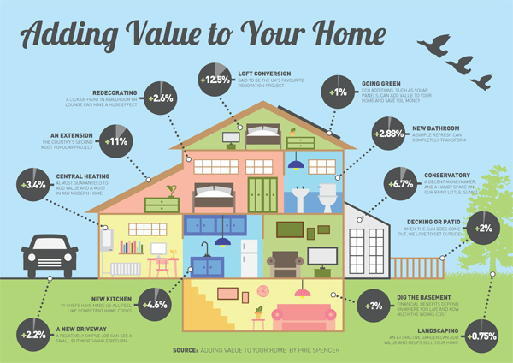
The Goal of The Project Select Criteria of a Real Property that Drive Its Market Value Most

Slide 3
Models Used:
Multivariate Linear Models
Stepwise Selection for P-Value
Stepwise Selection for AIC
Regularized Linear Models
Ridge
Lasso
Elastic Net
Tree Based Models
Regression Tree
Pruning
Random Forest

Slide 4
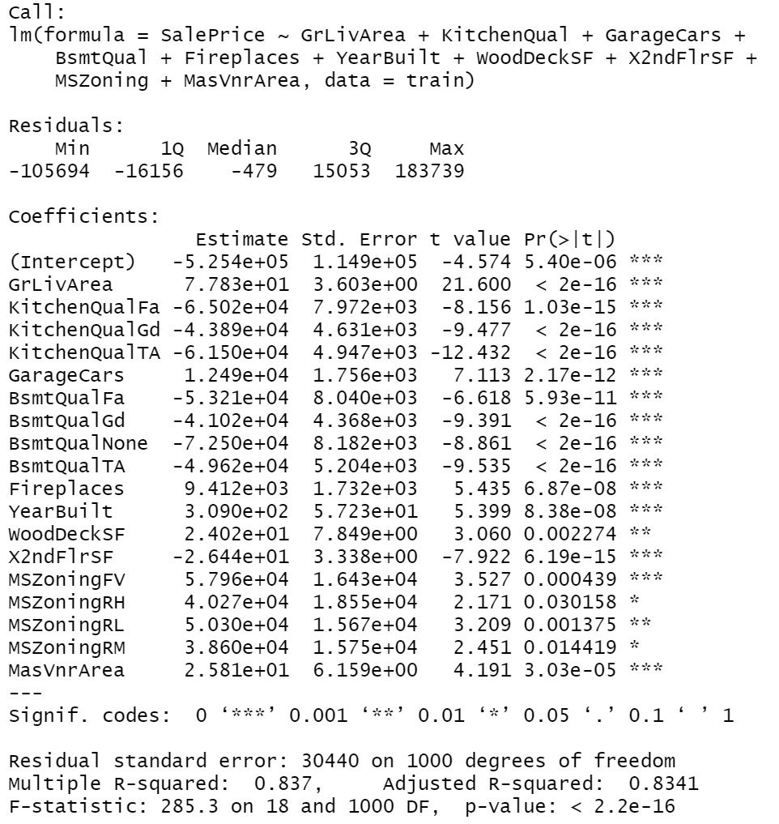
Multivariate Linear Model For Stepwise AIC Kaggle Score – 0.20803

Slide 5
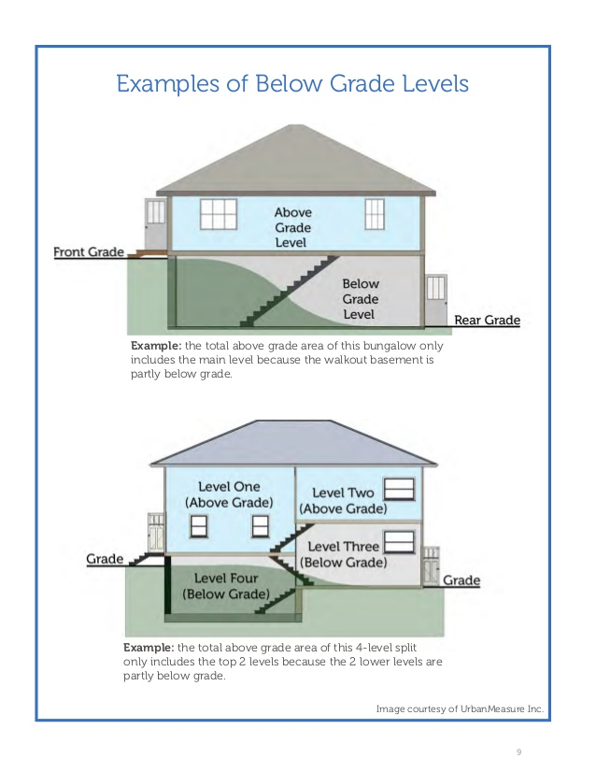
GrLivArea – Above Grade (Ground) Living Area Square Feet
+ $77.83 Per Square Foot

Slide 6
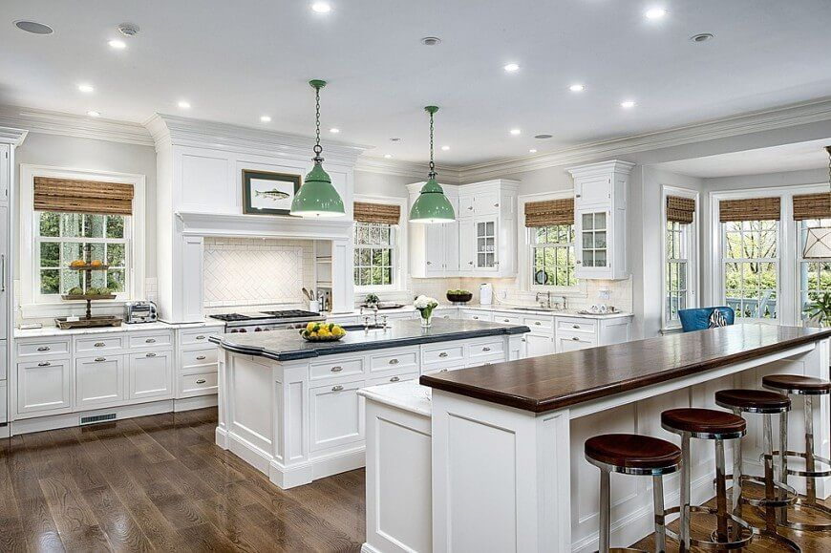
KitchenQual – Kitchen Quality
Excellent – Highest Good -$43,890 Typical -$61,500 Fair -$65,020

Slide 7

GarageCars – Size of Garage in Car Capacity
+$12,490 Per Car

Slide 8
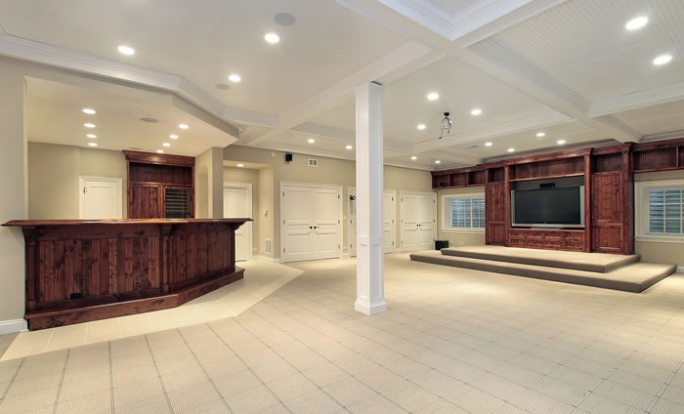
BsmtQual – Evaluates the Height of the Basement
Excellent (100+ inches) - Highest
Good (90-99 inches) -$41,020
Typical (80-89 inches) -$49,620
Fair (70-79 inches) -$53,210
No Basement -$72,500

Slide 9
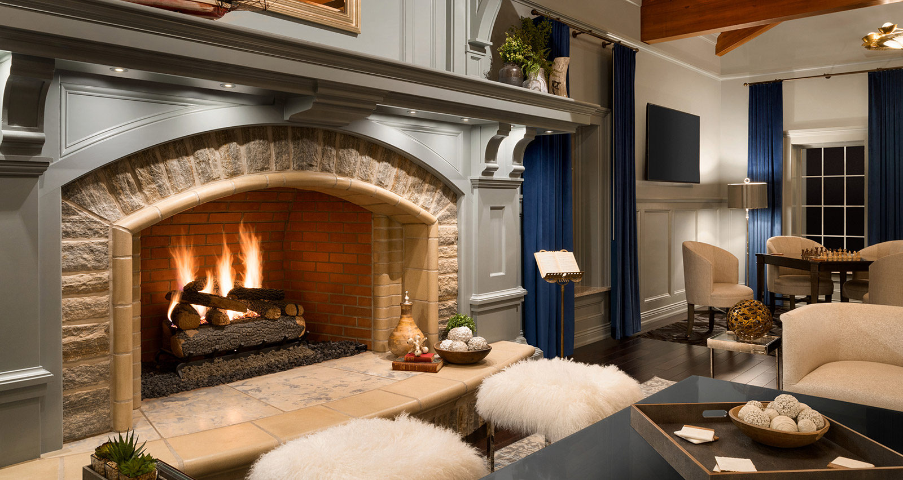
Fireplaces – Number of Fireplaces
+$9,412 Per Fireplace

Slide 10
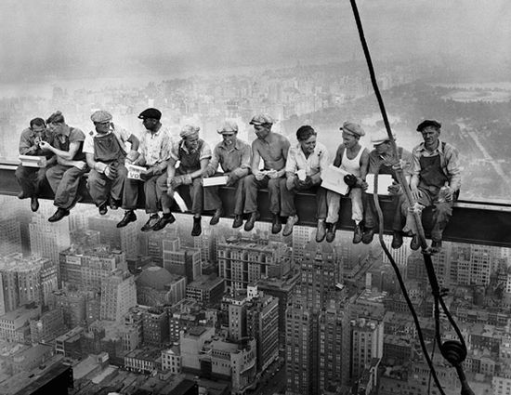
YearBuilt – Original Construction Date
+$309 Per Year

Slide 11
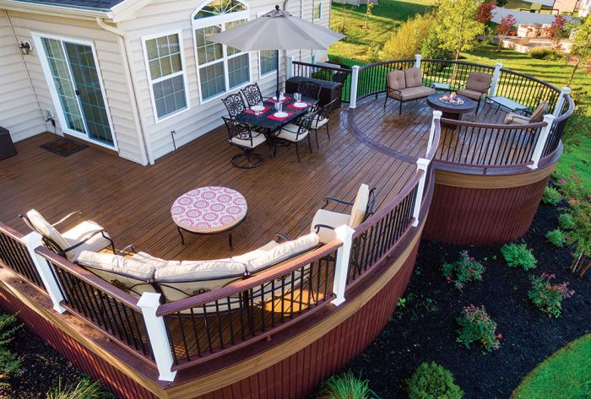
WoodDeckSF – Wood Deck Area in Square Feet
+$24.02 Per Square Foot

Slide 12
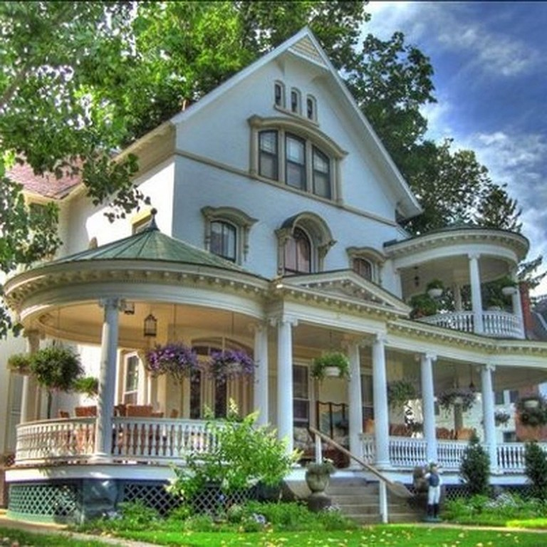
X2ndFlrSF – Second Floor Square Feet
-$26.44 Per Square Foot

Slide 13
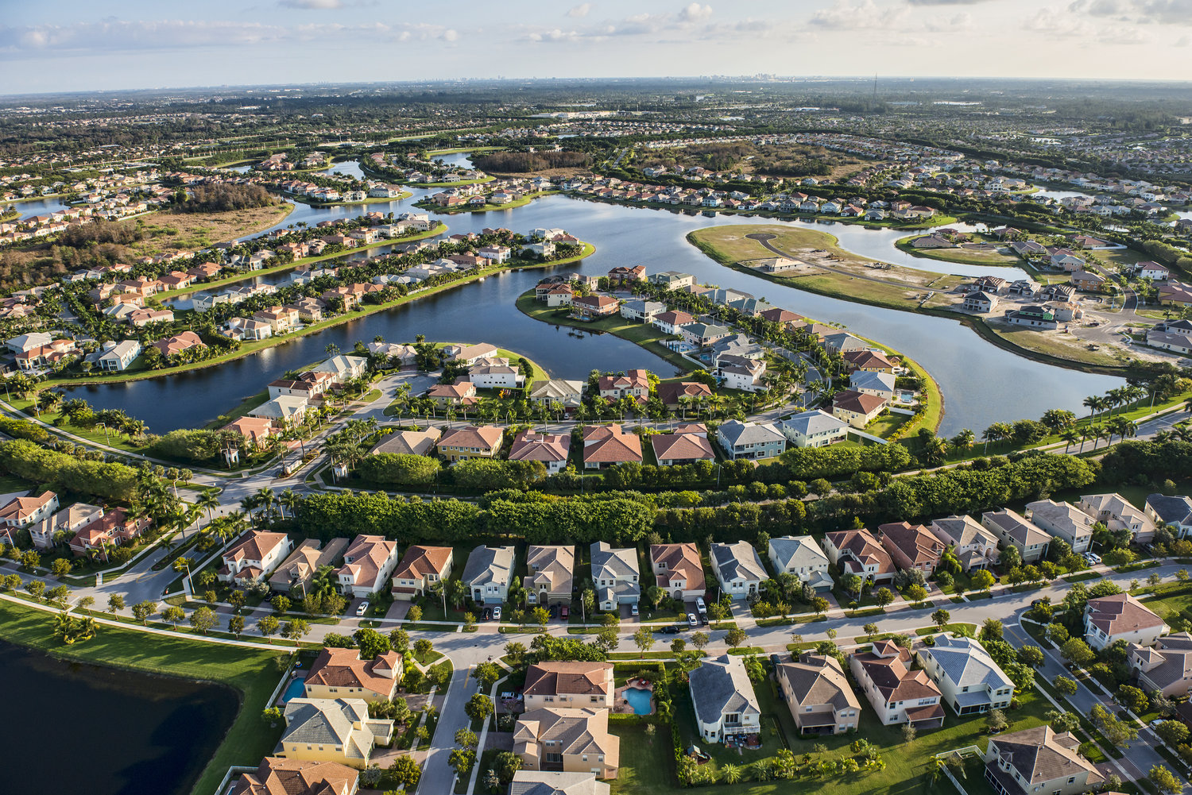
MSZoning – Identifies the General Zoning Classification of the Sale
All Other – Lowest
Floating Village Residential +$57,906
Residential High Density +$40,270
Residential Low Density +$50,300
Residential Medium Density +$38,600

Slide 14
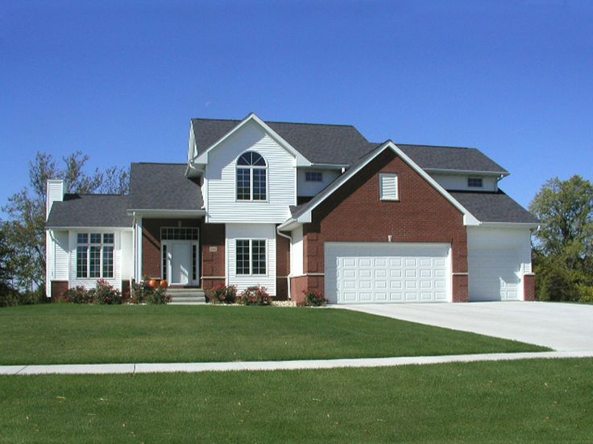
MasVnrArea – Masonry Veneer Area in Square Feet
+$25.81 Per Square Feet

